Slide 1
Thrombotic Thrombocytopenic Purpura (TTP)
By: Kendra Harris

Slide 2
Objectives
What is TTP
Types of TTP
Causes of TTP
Onset of TTP
Symptoms of TTP
Treatment of TTP
Outlook of TTP
What can we do as PT/PTA

Slide 3
What is TTP?
Thrombotic thrombocytopenic purpura (TTP) is a rare blood disorder. In TTP, blood clots form in small blood vessels throughout the body.
The clots can limit or block the flow of oxygen-rich blood to the body's organs, such as the brain, kidneys, and heart. As a result, serious health problems can develop.
The increased clotting that occurs in TTP also uses up platelets in the blood. Platelets are blood cell fragments that help form blood clots. These cell fragments stick together to seal small cuts and breaks on blood vessel walls and stop bleeding.
With fewer platelets available in the blood, bleeding problems can occur. People who have TTP may bleed inside their bodies, underneath the skin, or from the surface of the skin. When cut or injured, they also may bleed longer than normal.

Slide 4
Types of TTP
There are two main types of TTP, inherited and acquired.
In inherited TTP, the ADAMTS13 gene is faulty and doesn't prompt the body to make a normal ADAMTS13 enzyme. As a result, enzyme activity is lacking or changed.
Acquired TTP is the more common type of the disorder. This type of TTP mostly occurs in adults, but it can affect children.
In acquired TTP, the ADAMTS13 gene isn't faulty. Instead, the body makes antibodies (proteins) that block the activity of the ADAMTS13 enzyme.

Slide 5
Causes of TTP
This disease may be caused by a lack of, or problems with, a certain enzyme (a type of protein) that is involved in blood clotting. These changes cause clotting to occur in an abnormal way. As the platelets clump together in these clots, fewer platelets are available in the blood in other parts of the body to help with clotting. This can lead to bleeding under the skin and purple-colored spots called purpura.
In some cases, the disorder is passed down through families (inherited) and patients are born with naturally low levels of this enzyme. This condition also may be related to:
Bone marrow transplantation
Cancer
Chemotherapy
Hematopoietic stem cell transplantation
HIV infection
Hormone replacement therapy and estrogens
Pregnancy
Lupus
Medications (including ticlopidine, clopidogrel, guinine, and cyclosporine A)

Slide 6
Onset of TTP
Patients with thrombotic thrombocytopenic purpura (TTP) typically report an acute or subacute onset of symptoms related to neurologic dysfunction, anemia, or thrombocytopenia. Neurologic manifestations include alteration in mental status, seizures, hemiplegia, paresthesias, visual disturbance, and aphasia.

Slide 7
Symptoms of TTP
Bleeding into the skin or mucus membranes
Changes in consciousness
Confusion
Easy fatigue
Fever
Headache
Heart rate over 100 beats per minute
Pallor
Purplish spots in the skin produced by small bleeding vessels near the surface of the skin (purpura)
Shortness of breath
Speech changes
Weakness
Yellowish color to the skin (jaundice)

Slide 8
Treatment for TTP
Plasma exchange (plasmapheresis plus infusion of donor plasma) is used to remove the antibodies that are affecting clotting from the blood and also replace the missing enzyme.
First, you will have your blood drawn as if you were donating blood.
The plasma portion of the blood will be passed through a cell separator. The remaining portion of the blood will be saved.
Plasma will be added to it, and the blood will be returned to you through a transfusion.
This treatment is repeated daily until blood tests show improvement.

Slide 9
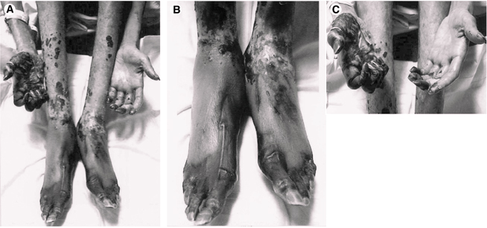
What does it look like?

Slide 10
Outlook
TTP is a rare disorder. It can be fatal or cause lasting damage, such as brain damage or a stroke, if it's not treated right away.
TTP usually occurs suddenly and lasts for days or weeks, but it can continue for months. Relapses can occur in up to 60 percent of people who have the acquired type of TTP. Many people who have inherited TTP have frequent flareups that need to be treated.
Plasmapharesis has greatly improved the outlook of the disorder.

Slide 11
What does this have to do with physical therapy?

Slide 12
References
McCrae KR, Sadler JE, Cines DB. Thrombotic thrombocytopenic purpura and the hemolytic uremic syndrome. In: Hoffman R, Benz EJ Jr, Shattil SJ, et al, eds. Hoffman Hematology: Basic Principles and Practice. 5th ed. Philadelphia, Pa: Churchill Livingstone Elsevier;2008:chap 139.
Schafer A. Hemorrhagic disorders: Abnormalities of platelet and vascular function. In: Goldman L, Ausiello D, eds. Cecil Medicine. 23rd ed. Philadelphia, Pa:Saunders Elsevier;2007:chap 179.
http://www.nlm.nih.gov/medlineplus/ency/article/000552.htm
http://www.nhlbi.nih.gov/health/health-topics/topics/ttp/
http://emedicine.medscape.com/article/206598-treatment

