Slide 1
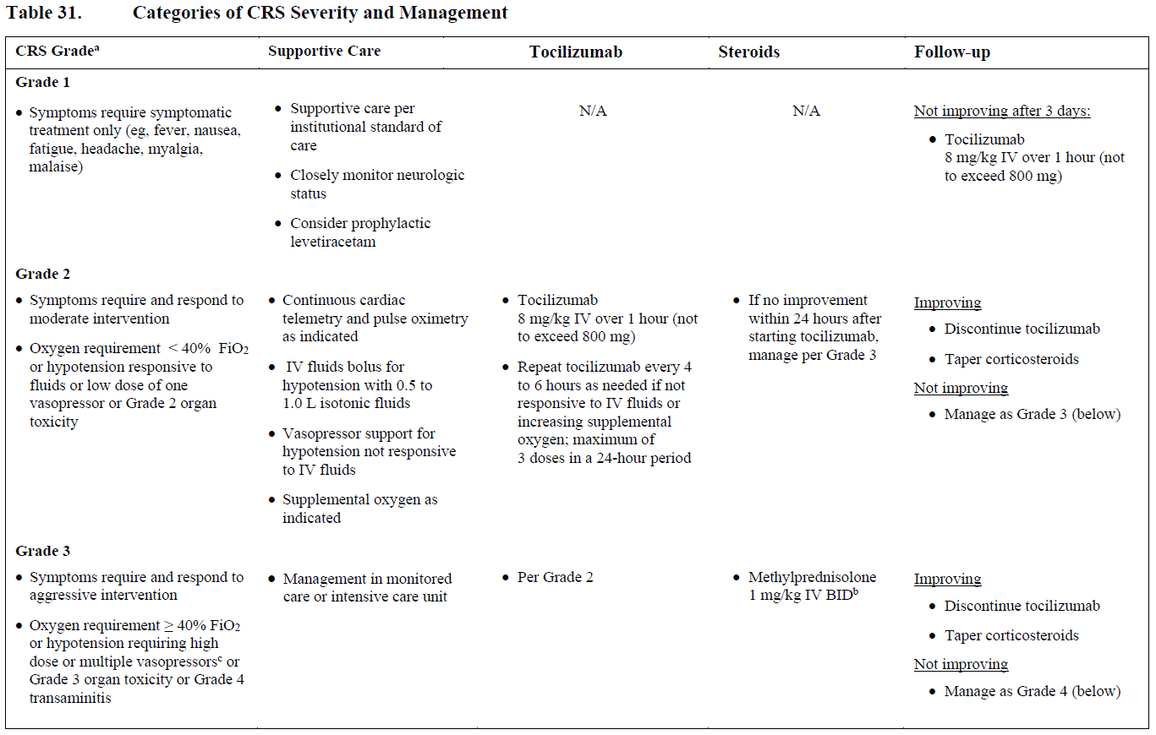
ZUMA-1
Cohort 3
KTE-C19
volgens CTCAE v. 4.03
Frequently check vital parameters (including O2 saturation)
NB Overweeg steeds tumorlysis syndroom
NB Overweeg steeds infectie
IV fluid bolus for hypotension (maximally two times 1.0 liter)
NB Check: profylaxe tocilizumab op dag 2 volgens protocol
NB Check: profylaxe levetiracetam vanaf dag 0 volgens protocol
Dexamethason at 10 mg IV every 6 hours
Vasopression needed (if no response to 2.0L fluids)
Consider IV siltuximab 11 mg/kg

Slide 2
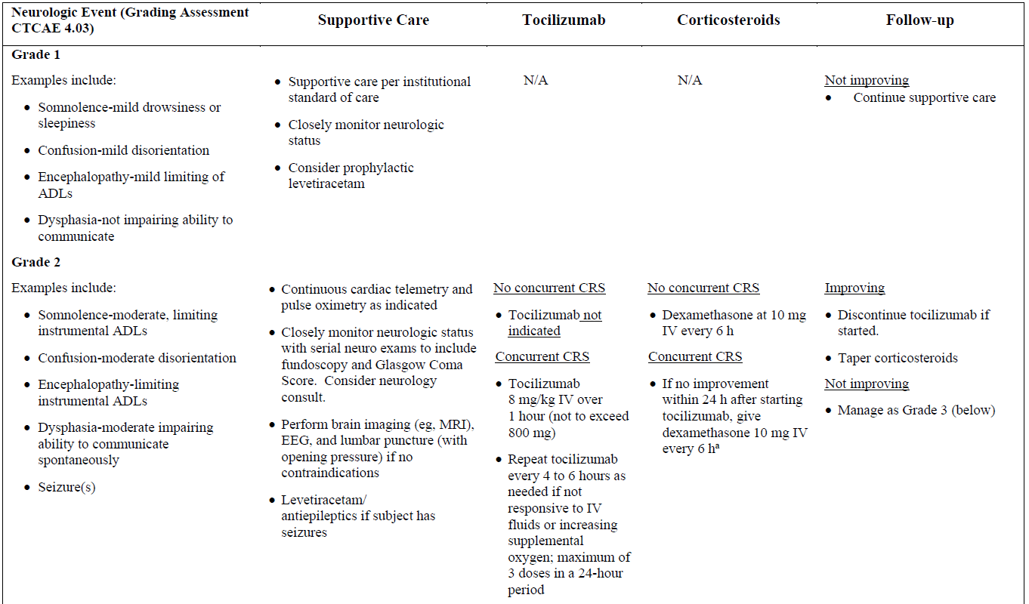
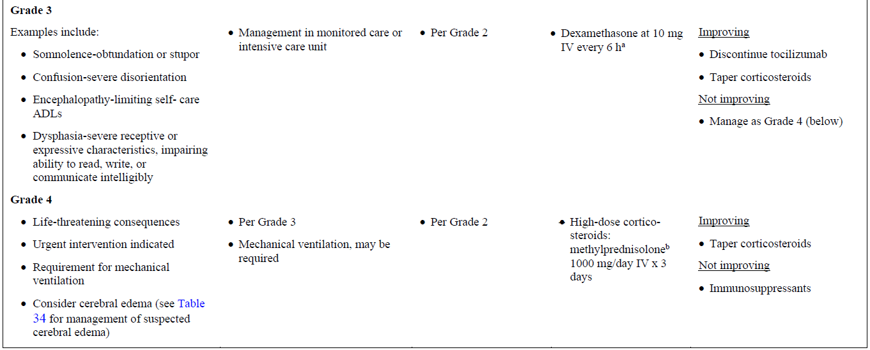
ZUMA-1
Cohort 3
KTE-C19
Frequently check vital parameters (including O2 saturation)
NB Overweeg steeds tumorlysis syndroom
NB Overweeg steeds infectie
Increase levetiracetam to 1000 mg BID
NB Check: profylaxe tocilizumab op dag 2 volgens protocol
NB Check: profylaxe levetiracetam vanaf dag 0 volgens protocol

