Slide 1
Teclistamab
Klinische les
Januari 2023
Alinda Vos
Internist-hematoloog

Slide 2
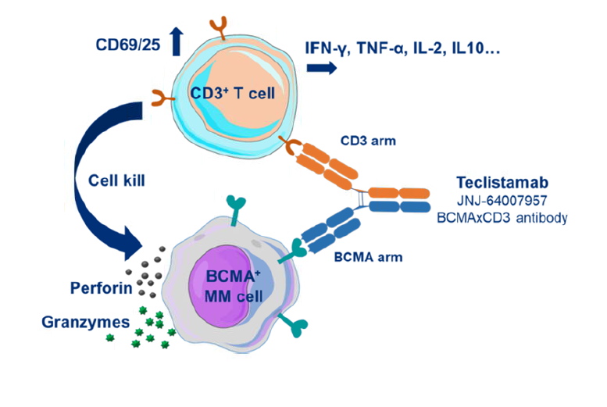

Slide 3
Voor wie?
Compassionate use programma
Patienten met relapsed/refractair multipel myeloom
Moeten behandeld zijn met tenminste een middel uit alle onderstaande groepen
Proteasoom inhibitor
Immunomodulator
antiCD38 behandeling
Geen andere reguliere behandeling mogelijk
Niet geschikt voor deelname aan een studie

Slide 4
Effectiviteit en bijwerkingen (1)
Fase 1 MajesTEC-1 studie: 157 pt’en behandeld met ‘uitbehandeld’ myeloom
40 patienten krijgen aanbevolen dosis
Overall response 65% na 6 maanden
Bijwerkingen
CRS (70%, allen < graad 3)
Neutropenie (65%)
Bron: Lancet. 2021 Aug 21;398(10301):665-674.

Slide 5
Effectiviteit en bijwerkingen (2)
Fase ½ studie: 165 patienten met ‘uitbehandeld’ myeloom
63% hadden een response na 14 maanden
65 patienten (ca 40%) hadden een complete response of beter
Mediane duur van response 18 maanden
Bijwerkingen
CRS in 73% (graad 3 of meer 0.6%)
ICANS 3% (allen < graad 3)
Pancytopenie (vaak)
Infecties (vaak)
Bron: N Engl J Med 2022; 387:495-505
N Engl J Med 2022; 387:495-505

Slide 6
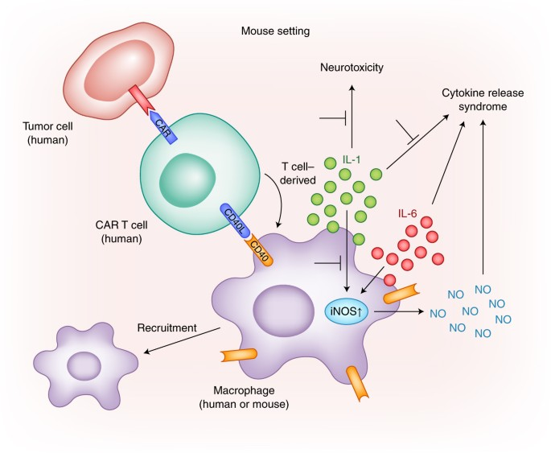
Cytokine release syndroom
Suprafysiologische immuunresponse.
Immuunsysteem ‘aangezet’ door immuuntherapie (CAR-T, bispecieke antistof)
Veel productie van cytokines
Hoog CRP, hoog ferritine, cytopenieen
Klinisch koorts en orgaan dysfunctie: sepsis beeld
Nature Medicine volume 24, pages705–706 (2018)

Slide 7
Immune effector cell-associated neurotoxicity syndrome (ICANS)
Pathofysiologie niet volledig begrepen
Zelfde mechanisme als CRS
Door inflammatie en hoge levels cytokines gaat waarschijnlijk de bloed-hersenbarriere ‘lekken’ -> systemische inflammatie in het brein
Verandering van corticale en subcorticale functies
Soms: diffuus hersenoedeem
Kliniek
begin vaak met aandachtsproblemen (desoriëntatie) en taal/spraakproblemen
Kan snel gaan, in uren!
Ernstig: desoriëntatie, verminderd bewustzijn, epileptische insulten

Slide 8
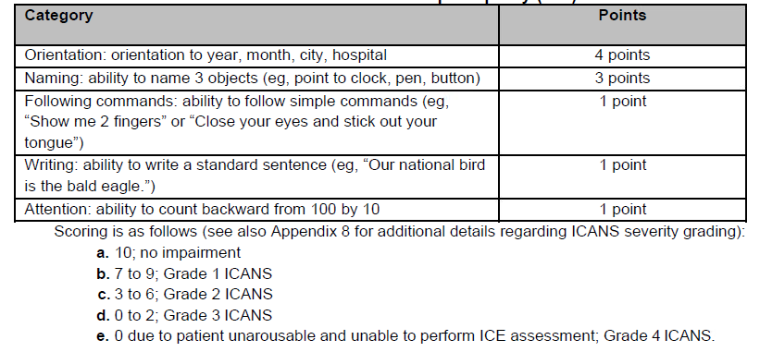
Immune Effector Cell-associated encephalopathy score (ICE score)

Slide 9
Recommended Management of Cytokine Release Syndrome
 | Presenting Symptoms | Treatment Options
 |  | Tocilizumabª | Corticosteroids^{b}
Grade 1 | Temperature ≥38°C^{c} | May be considered | Not applicable
Grade 2 | Temperature ≥38°C^{c} with either: Hypotension responsive to fluids and not requiring vasopressors. Or oxygen requirement of low-flow nasal cannula^{d} or blow-by | Administer tocilizumabb 8 mg/kg IV over 1 hour (not to exceed 800 mg). Repeat tocilizumab every 8 hours as needed if not responsive to IV fluids or increasing supplemental oxygen. Limit to a maximum of 3 doses in a 24-hour period; maximum total of 4 doses. | Manage per guidance below if no improvement within 24 hours of starting tocilizumab.
Grade 3 | Temperature ≥38°C^{c} with either: Hypotension requiring 1 vasopressor with or without vasopressin. Or, oxygen requirement of high-flow nasal cannula^{d}, facemask, non-rebreather mask, or Venturi mask | Administer tocilizumab 8 mg/kg IV over 1 hour (not to exceed 800 mg). Repeat tocilizumab every 8 hours as needed if not responsive to IV fluids or increasing supplemental oxygen. Limit to a maximum of 3 doses in a 24-hour period; maximum total of 4 doses. | If no improvement, administer methylprednisolone 1 mg/kg IV twice daily or equivalent dexamethasone (eg, 10 mg IV every 6 hours). Continue corticosteroids use until the event is Grade 1 or less, then taper over 3 days.
Grade 4 | Temperature ≥38°C^{c} with either: Hypotension requiring multiple vasopressors (excluding vasopressin). Or, oxygen requirement of positive pressure (eg, CPAP, BiPAP, intubation, and mechanical ventilation) | Administer tocilizumab 8 mg/kg IV over 1 hour (not to exceed 800 mg). Repeat tocilizumab every 8 hours as needed if not responsive to IV fluids or increasing supplemental oxygen. Limit to a maximum of 3 doses in a 24-hour period; maximum total of 4 doses. | As above or administer methylprednisolone 1000 mg IV per day for 3 days per physician discretion. If no improvement or if condition worsens, consider alternate immunosuppressants.^{b}
Refer to tocilizumab prescribing information for details. Monoclonal antibodies targeting cytokines may be considered based on institutional practice for unresponsive CRS. Attributed to CRS. Fever may not always be present concurrently with hypotension or hypoxia as it may be masked by interventions such as antipyretics or anticytokine therapy (e.g., tocilizumab or steroids). Low-flow nasal cannula is ≤6 L/min, and high-flow nasal cannula is >6 L/min.

Slide 10
Recommended Management of ICANS
 | Presenting Symptomsª | Concurrent CRS | No Concurrent CRS
Grade 1 | ICE score 7-9^{b} or depressed level of consciousnessc: awakens spontaneously. | Management of CRS as appropriate per Table CRS. Monitoring of neurologic symptoms and consider neurology consultation and evaluation, per physician discretion. | Monitor neurologic symptoms and consider neurology consultation and evaluation, per physician discretion.
 |  | Consider non-sedating, anti-seizure medicines (eg, levetiracetam) for seizure prophylaxis.
Grade 2 | ICE score-3-6^{b} or depressed level of consciousnessc: awakens to voice. | Management of CRS as appropriate per Table CRS. If no improvement after starting tocilizumab, administer dexamethasone^{d} 10 mg IV every 6 hours if not already taking other corticosteroids. Continue dexamethasone use until the event is Grade 1 or less, then taper. | Administer dexamethasoned 10 mg intravenously every 6 hours. Continue dexamethasone use until the event is Grade 1 or less, then taper.
 |  | Consider non-sedating, anti-seizure medicines (eg, levetiracetam) for seizure prophylaxis. Consider neurology consultation and other specialists (ie, intensivists) for further evaluation, as needed.
Grade 3 | ICE score-0-2^{b} or depressed level of consciousnessc: awakens only to tactile stimulus, or seizures^{c}, either: any clinical seizure, focal or generalized, that resolves rapidly, Or non-convulsive seizures on EEG that resolve with intervention, Or raised ICP: focal/local edema on neuroimaging^{c}. | Management of CRS as appropriate per Table CRS. In addition, administer dexamethasone^{d} 10 mg IV with the first dose of tocilizumab and repeat dose every 6 hours. Continue dexamethasone use until the event is Grade 1 or less, then taper. | Administer dexamethasone^{d} 10 mg IV every 6 hours. Continue dexamethasone use until the event is Grade 1 or less, then taper.
 |  | Consider non-sedating, anti-seizure medicines (eg, levetiracetam) for seizure prophylaxis. Consider neurology consultation and other specialists (ie, intensivists) for further evaluation, as needed.
Grade 4 | ICE score-0^{b} or depressed level of consciousness^{c} either: patient is unarousable or requires vigorous or repetitive tactile stimuli to arouse, or stupor or coma, or seizures^{c}, either: life-threatening prolonged seizure (>5 min), or repetitive clinical or electrical seizures without return to baseline in between, or motor findingsc: deep focal motor weakness such as hemiparesis or paraparesis, or raised ICP/cerebral edemac, with signs/symptoms such as: diffuse cerebral edema on neuroimaging, or decerebrate or decorticate posturing, or cranial nerve VI palsy, or papilledema, or Cushing's triad. | Management of CRS as appropriate per Table CRS. As above, or consider administration of methylprednisolone 1000 mg IV per day with first dose of tocilizumab and continue methylprednisolone 1000 mg IV per day for 2 or more days, per physician discretion. | As above, or consider administration of methylprednisolone 1000 mg IV per day for 3 days; if improves, then manage as above.
 |  | Consider non-sedating, anti-seizure medicines (eg, levetiracetam) for seizure prophylaxis. Consider neurology consultation and other specialists (ie, intensivists) for further evaluation, as needed. In case of raised ICP/cerebral edema, refer to Table 5 in the Pre-approval access treatment guidelines for Teclistamab (also available at de.heer.eu) for additional management guidelines.
Management is determined by the most severe event, not attributable to any other cause If patient is arousable and able to perform Mental Status assessment, the following domains should be tested: orientation, naming, following commands, writing, and attention Attributable to no other cause. All references to dexamethasone administration are dexamethasone or equivalent

Slide 11
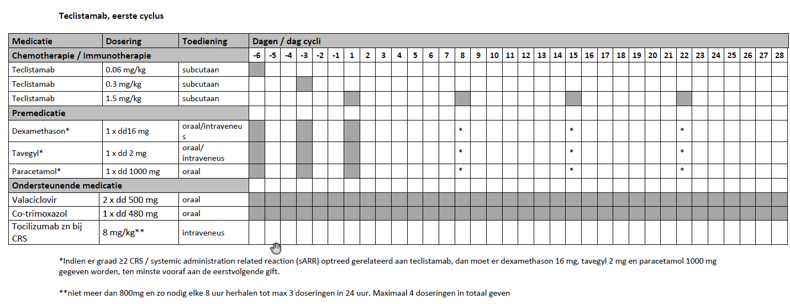
Toedieningsschema eerste cyclus

Slide 12
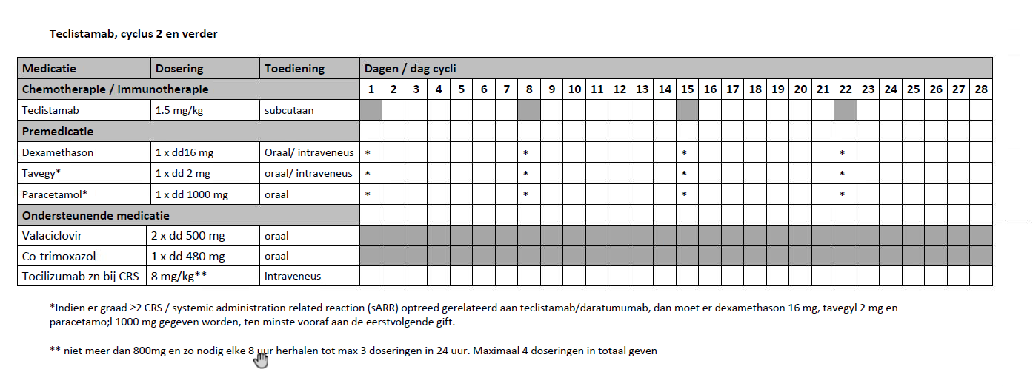
Toedieningsschema cyclus 2 en verder

Slide 13
Aanvullende informatie
Zenya document: Teclistamab
Website: de-heer.eu voor brondocumenten van fabrikant
Pre-approval access treatment guidelines for Teclistamab
Hier komen de tabellen uit het Zenya Teclistamab protocol uit.
Teclistamab informatie voor de patient
Investigational Product Preparations Instructions

